Slide 2
Agenda
Hello Wars: TankBlaster
Game overview
Game mechanics
How to start
Bot configuration

Slide 3
Game overview

Slide 4
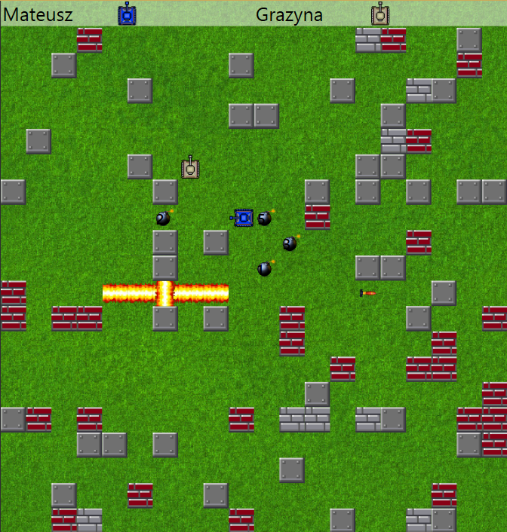






Game overview
Hello Wars: TankBlaster
1 vs 1 gameplay
One mission – destroy your opponent
Tournament ladder or round robin mode
Available board tiles:
Weapons
Empty |  | Regular
Fortified |  | Indestructible
Bomb |  | Missile

Slide 5
Game mechanics

Slide 6
Arena
Hello Wars: TankBlaster
One host desktop application – Arena, responsible for:
Game interface,
Round management:
Ask bots for their moves and execute them
Handle game mechanic – i.e missiles and bombs explosions

Slide 7
Bots
Hello Wars: TankBlaster
In one round bot can make two actions:
One movement:
Only one tile in four directions: up, down, left, right
Only through empty tiles
If arrena detect a wrong move, action will be ignored
One battle action:
Drop a bomb
Fire a missile

Slide 8
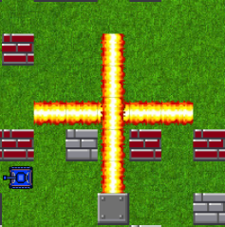
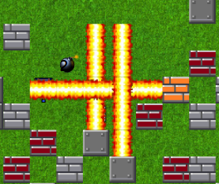
Explosions
Hello Wars: TankBlaster
Explosion conditions:
Bomb – timer expiration
Missile – collision with another object
Explosion radius:
Specified in configuration file
Affects only fields in horizontal and vertical axis, no diagonals
Chained explosions:
Each explosion triggers other bombs/missiles instantly

Slide 9
How to start ?

Slide 10
How to start ?
Hello Wars: TankBlaster
Bot must be implemented as a web application
And contains 2 methods:
GET: <bot_url>/Info – takes no parameters and return bot information
POST: <bot_url>/PerformNextMove – takes BattlefieldInfo as a parameter and returns BotMove
Sample bots implementations can be found at
https://github.com/michalczerwinski/hello_wars

Slide 11
Arena configuration
Hello Wars: TankBlaster
Open arena configuration file
change game type you wish to play
change elimination type name to your preferred elimination type
modify bot urls. If you need more players, just type a few copies of the same url. They will be interpreted as a separate bots
When you run the arena, it should automatically connect with bots. Press "Play" to start game

Slide 12
.NET bot configuration
Hello Wars: TankBlaster
Open some bot project from "dotNet" folder, rebuild it or restore packages for solution and then rebuild. Run solution. Bot should be visible in IIS server. This is the moment you can test your bot localy.
Open IIS and create new website using binaries from "dotNet" folder project - right click on "Sites" -> "Add Web Site"
Change Port number to some unused port (eg. 82)
Type in website name
Set physical path to your bot application folder and Click OK.
Right click on your bot web site -> "Edit Permissions" -> "Security" bookmark
Click "Edit" and then "Add" to grant permission to user. Dialog will appear, type "IIS APPPOOL\{your application name}" in text box. Change Location for your local host location ie. computer name. Click Ok.
Choose your user and grant him Full control, click OK and go back to IIS.
Run sample bot (if not already running)
Make sure that Windows Features (Accessible from Add/Remove programs in Control Panel) -> Internet Information Services -> WWW services -> Asp.Net 4.5 is checked.
Check your bot in web browser eg. "http://localhost:82/info"

Slide 13
PHP bot configuration
Hello Wars: TankBlaster
Download WAMP server from http://www.wampserver.com/ and install it
Copy folder "TankBlasterBot" (hello_wars/PHP/TankBlaster/) to your WAMP server www folder (default "C:/wamp/www" on Windows)
Run WAMP
Your bot should be accessible at "http://localhost/tankblasterbot/". Check "http://localhost/tankblasterbot/info" in your browser to see if it works

Slide 14
Java bot configuration
Hello Wars: TankBlaster
Import bot from HELLOWARS/JAVA folder to your workspace
Find InetSocketAddress method in TankBlasterBot class and change port number to some valid port number
Run project
You can check if bot is running typing http://localhost:9065/info in webbrowser
You can disable your bot calling http://localhost:9065/close

Slide 15
Node.js bot configuration
Hello Wars: TankBlaster
Download Node.js from https://nodejs.org/en/ and install it
Copy folder "TankBlasterBot" (hello_wars/nodeJs/TankBlasterBot/) to your local directory
Open command prompt and go to project directory
Type "npm install express" to install express framework for Node.js
Type "npm install body-parser" body-parser extension for Node.js
Type "node app.js" to run application
Your bot should be accessible at "http://localhost:8081/". Check "http://localhost:8081/info" in your browser to see if it works

Slide 16
Thank you for attention
SMT Software Services
Kościuszki 29
50-011 Wrocław, PL
Tel. 0048 71 769 59 00
Fax 0048 71 769 59 01
office@smtsoftware.com
www.smtsoftware.com

